Slide 1


DATA VISUALIZATION IN R
NETFLIX MOVIES AND TV SHOWS ANALYSIS
PRESENTATION
by :
SUBHAM MEHER
2503031590041

Slide 2


Dashboard Overview
Objective
Analyze the Netflix Movies and TV Shows dataset using R.
Explore trends in Netflix content using different visualization techniques.
Identify patterns in content type, country-wise distribution, release trends, duration, and ratings.

Slide 3
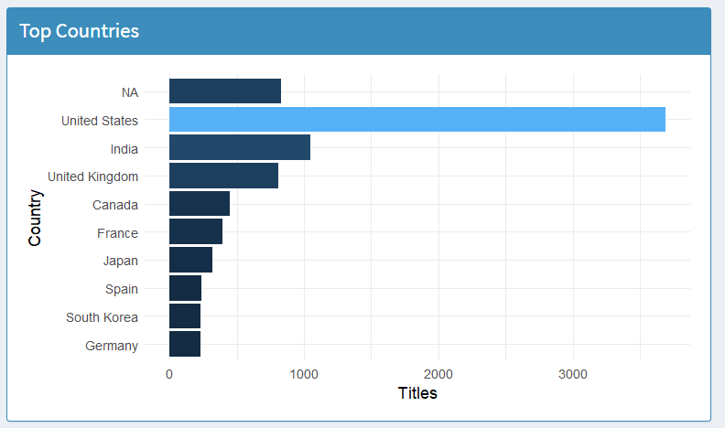

Bar Chart – Top 10 Countries by Number of Netflix Titles
Observations
The United States contributes the highest number of Netflix titles.
India is among the top content-producing countries.
Most of Netflix's content comes from a few major entertainment industries.
Some countries have significantly fewer titles, showing unequal content distribution.
Conclusion
Netflix has a strong presence in North America and Asia.
The platform focuses heavily on countries with large entertainment industries.

Slide 4


country_data <- netflix %>%
separate_rows(country, sep=",") %>%
mutate(country=str_trim(country)) %>%
count(country, sort=TRUE) %>%
slice(1:10)
output$countryPlot <- renderPlot({
ggplot(country_data,
aes(reorder(country,n),n,
fill=n))+
geom_col()+
coord_flip()+
labs(
x="Country",
y="Titles"
)+
theme_minimal(base_size=14)+
theme(
legend.position="none"
)
})

Slide 5
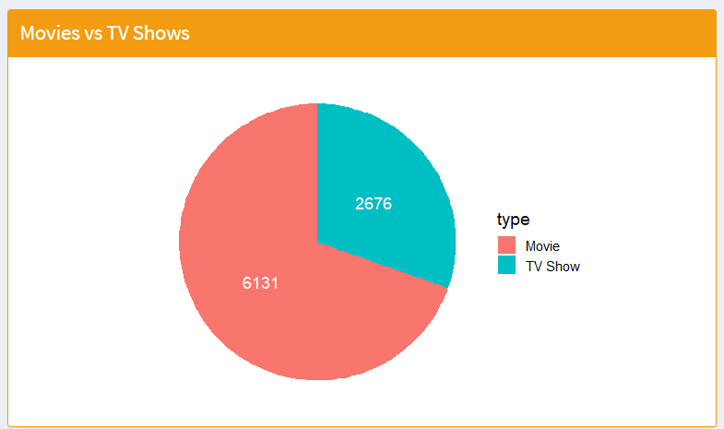

Pie Chart – Movies vs TV Shows
Observations
Movies account for the majority of Netflix content.
TV Shows represent a smaller but significant share.
The platform offers more standalone movie content than long-running series.
Conclusion
Netflix emphasizes movies while maintaining a diverse TV Show collection.
This indicates that movie licensing and production remain a major strategy.
Structured Data

Slide 6
type_data <- netflix %>%
count(type)
output$piePlot <- renderPlot({
ggplot(type_data,
aes(x="",
y=n,
fill=type))+
geom_bar(
width=1,
stat="identity"
)+
coord_polar("y")+
theme_void(base_size=15)+
geom_text(
aes(label=n),
position=position_stack(vjust=0.5),
color="white",
size=5
)
})

Slide 7
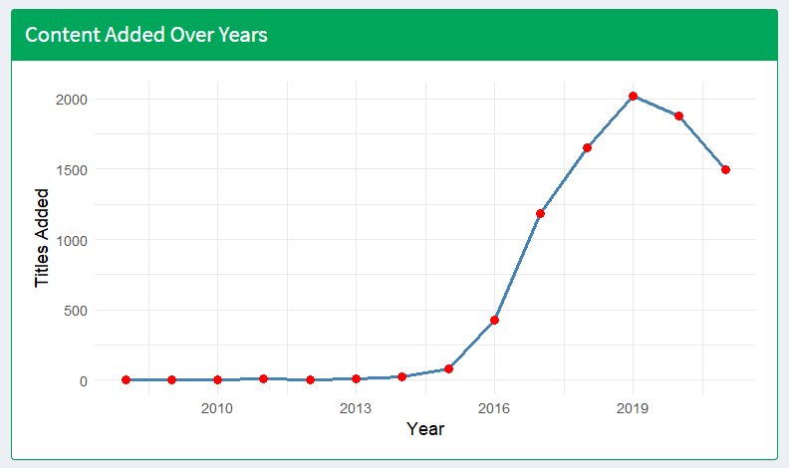

Observations
The number of titles added increased steadily over time.
A sharp rise is visible during Netflix's expansion years.
After reaching a peak, the growth slows slightly in later years.
Conclusion
Netflix rapidly expanded its content library over several years.
The platform invested heavily in increasing content to attract global audiences.

Slide 8

year_data <- netflix %>%
filter(!is.na(year_added)) %>%
count(year_added)
output$linePlot <- renderPlot({
ggplot(year_data,
aes(year_added,n))+
geom_line(
size=1.3,
color="steelblue"
)+
geom_point(
size=3,
color="red"
)+
labs(
x="Year",
y="Titles Added"
)+
theme_minimal(base_size=14)
})

Slide 9

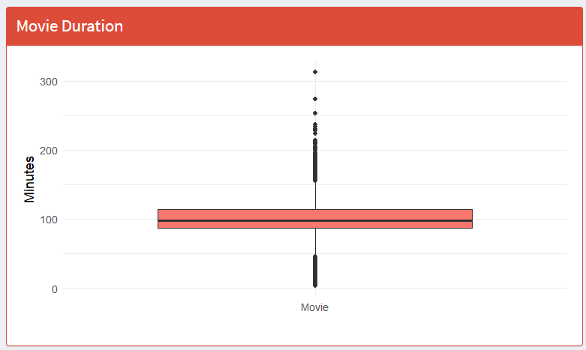

Box Plot – Movie Duration Distribution
Observations
Most movies fall within a common duration range.
A few movies have exceptionally long durations (outliers).
The median duration represents the typical Netflix movie length.
Conclusion
Netflix primarily offers standard-length movies.
Extremely short or very long movies are relatively uncommon.

Slide 10


RIMBERIO
movies <- netflix %>%
filter(type=="Movie") %>%
mutate(duration_num=as.numeric(str_extract(duration,"\\d+")))
output$boxPlot <- renderPlot({
ggplot(movies,
aes(x=type,
y=duration_num,
fill=type))+
geom_boxplot()+
labs(
x="",
y="Minutes"
)+
theme_minimal(base_size=14)+
theme(
legend.position="none"
)
})

Slide 11
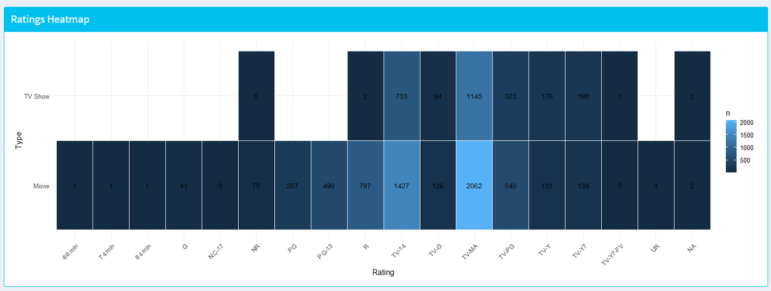
Heatmap – Rating vs Content Type
Observations
Certain ratings appear much more frequently than others.
TV Shows and Movies differ in their rating distributions.
Mature audience ratings (such as TV-MA) are common in Netflix's catalog.
Conclusion
Netflix provides content suitable for multiple age groups.
Adult-oriented content forms a significant portion of the platform's library.

Slide 12

heat_data <- netflix %>%
count(type,rating)
output$heatPlot <- renderPlot({
ggplot(
heat_data,
aes(
rating,
type,
fill=n
)
)+
geom_tile(color="white")+
geom_text(aes(label=n),
size=4)+
labs(
x="Rating",
y="Type"
)+
theme_minimal(base_size=13)+
theme(
axis.text.x=
element_text(
angle=45,
hjust=1
)
)
})
}

Slide 13



THANK YOU!
FOR YOUR ATTENTION
by SUBHAM MEHER

